Slide 1







Playing with Tiny bit
Spinning top
Yahboom

Slide 2









Contents
Preparation
Learning goal
Search for blocks
Combine blocks
Experimental phenomena
Yahboom

Slide 3

Preparation
This course mainly uses the accelerometer that comes with micro:bit. When I hold the Tiny-bit and move it, the values of X, Y and Z in the three directions of acceleration will change.
In this experiment, we use the data be changed in the X direction.
Yahboom

Slide 4
Preparation
Programming method:
Mode 1 online programming: First, we need to connect the micro:bit to the computer by USB cable. The computer will pop up a USB flash drive and click on the URL in the USB flash drive: http://microbit.org/ to enter the programming interface. Add the Yahboom package: https://github.com/YahboomTechnology/Tiny-bitLib to program.
Mode 2 offline programming: We need to open the offline programming software. After the installation is complete, enter the programming interface, click【New Project】, add Yahboom package: https://github.com/YahboomTechnology/Tiny-bitLib, you can program.
Yahboom

Slide 5
Learning goal
1.Learn how to use compass graphically program building blocks
2.The function is realized by programming: When we tilt the Tiny-bit by hand, measuring the magnitude of the data is changed in the x-axis direction of the accelerometer, and set the time of the Tiny-bit rotation based on this data.
Yahboom

Slide 6

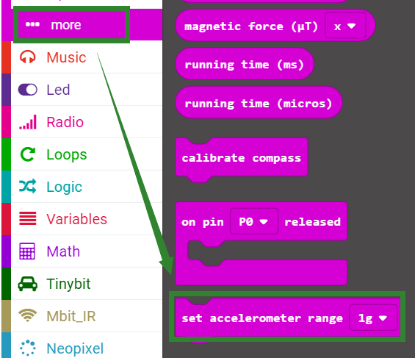
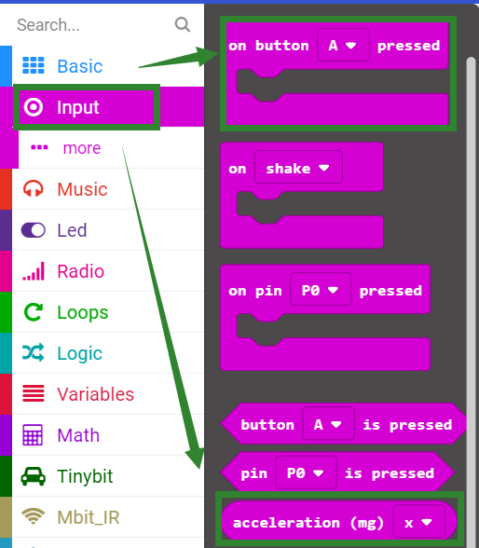
Search for block
The following is the location of the building blocks required for this programming.
Yahboom

Slide 7
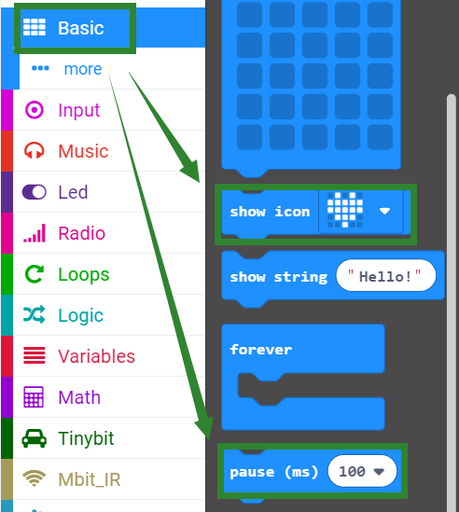
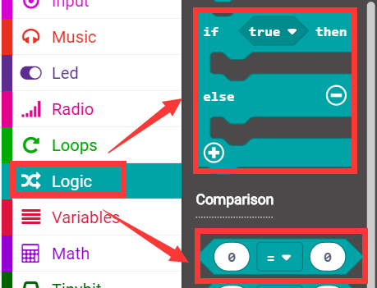
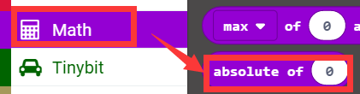
Search for block
Yahboom

Slide 8
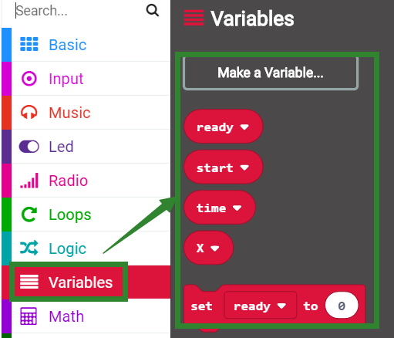
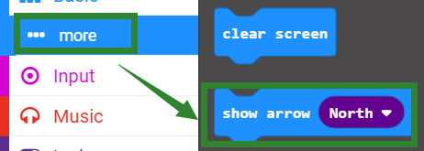
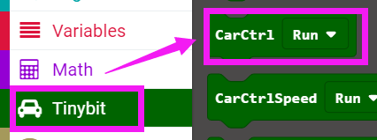
Search for block
Yahboom

Slide 9
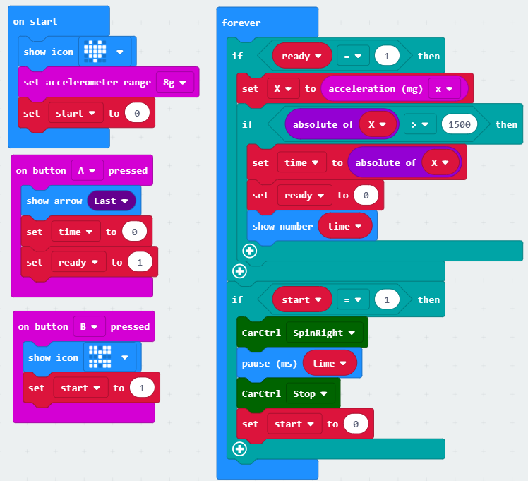
Combine block
The summary program is shown below:
Yahboom

Slide 10
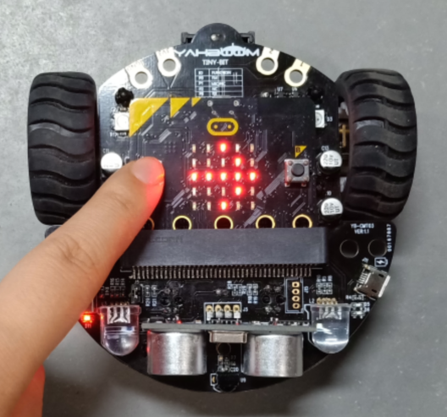
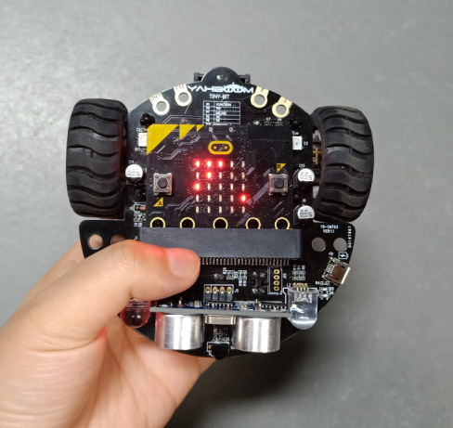
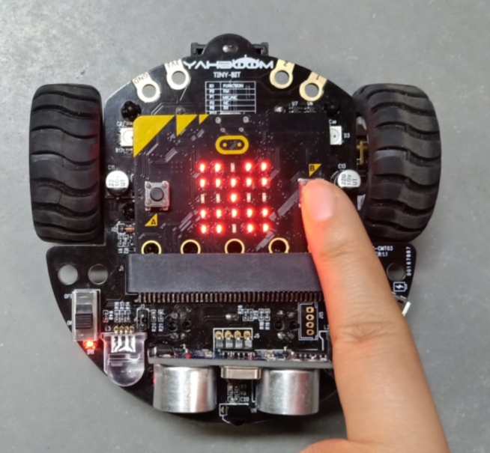
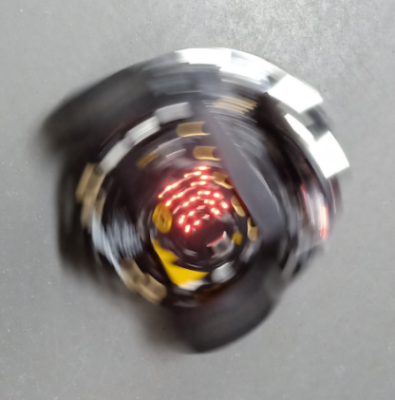
Experimental phenomena
After the program is downloaded, open the power of robot car, and micro:bit dot matrix will display a heart.
When we press the A button, an arrow pointing to the B button will appear as shown in Figure 1. Then we can shake Tiny-bit. We can see that the micro:bit dot matrix will display data of the x-axis will changed of the accelerometer , as shown in Figure 2 below.
Next, we need to put the Tiny-bit on the ground or on the desktop. After pressing the B button, the a butterfly will be displayed on the micro:bit dot matrix as shown in Figure 3, then Tiny-bit starts to spin right as shown in Figure 4. As shown, the spin right time is the absolute value of the accelerometer x-axis change data.
After the time is up, Tiny-bit will stop.
Until we press the A button again, shake the Tiny-bit, change the accelerometer data, and then press the B button, the Tiny-bit will spin again.
Figure 1
Figure 2
Figure 3
Figure 4
Yahboom

Slide 11
Inspire Creativity Embrace Innovation
Thank you!!!

